Slide 1
Statistical Process Control
Roberts Center for Pediatric Resarch
2/3/2020

Slide 2


Presentation Outline
2 data sets
Control Charts
P-Chart
X-Bar and R Chart
Discuss sources of variation
Q&A Session

Slide 3

P-Charts
Binary Outcomes
Sample size not constant
Discrete Data
Independence

Slide 4


Goldeneye for Nintendo 64
Released in 1997
18 missions
3 level difficulties
Agent
Secret Agent
00 Agent

Slide 5
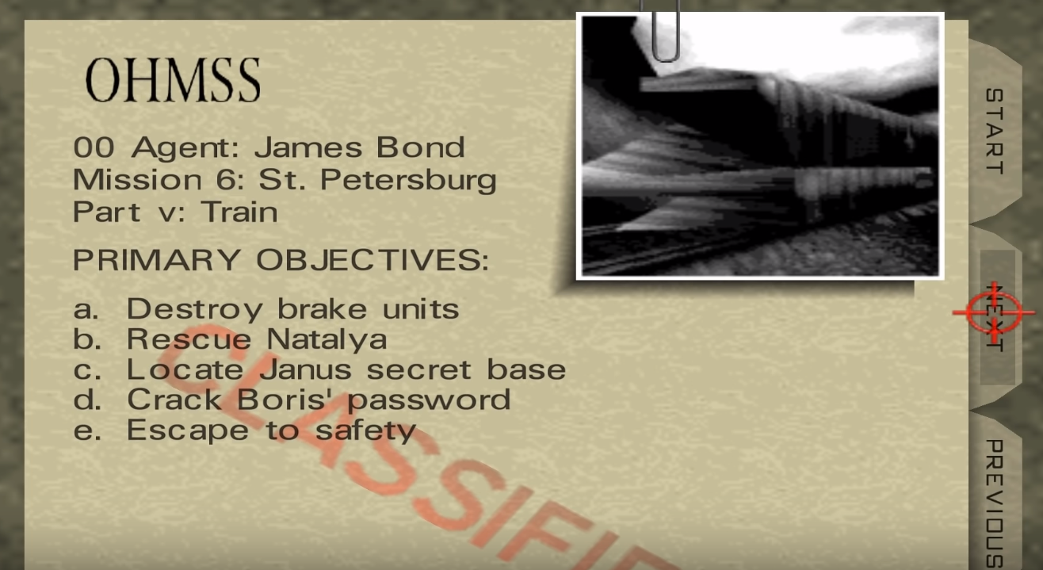
The Mission

Slide 6


The Experiment
10 “Sessions” of grouped attempts
Random attempt allocation
Binary Outcome
Measuring success rate per session

Slide 7



Important Factors
Mean success rate
# of wins / # of attempts
Confidence bounds
$CL= \overline{p} ±3\sqrt{\frac{\overline{p}(1−\overline{p)}}{n_{j}}}$
Success rate per session

Slide 8
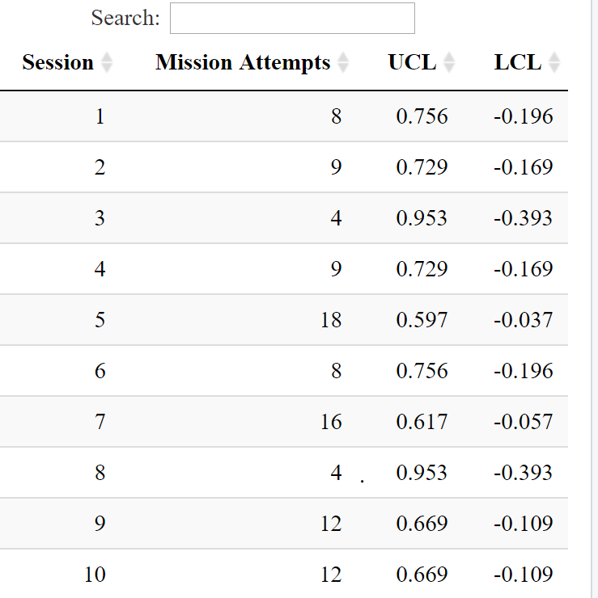
Confidence Bounds
Confidence Bounds must be between 0 and 1

Slide 9
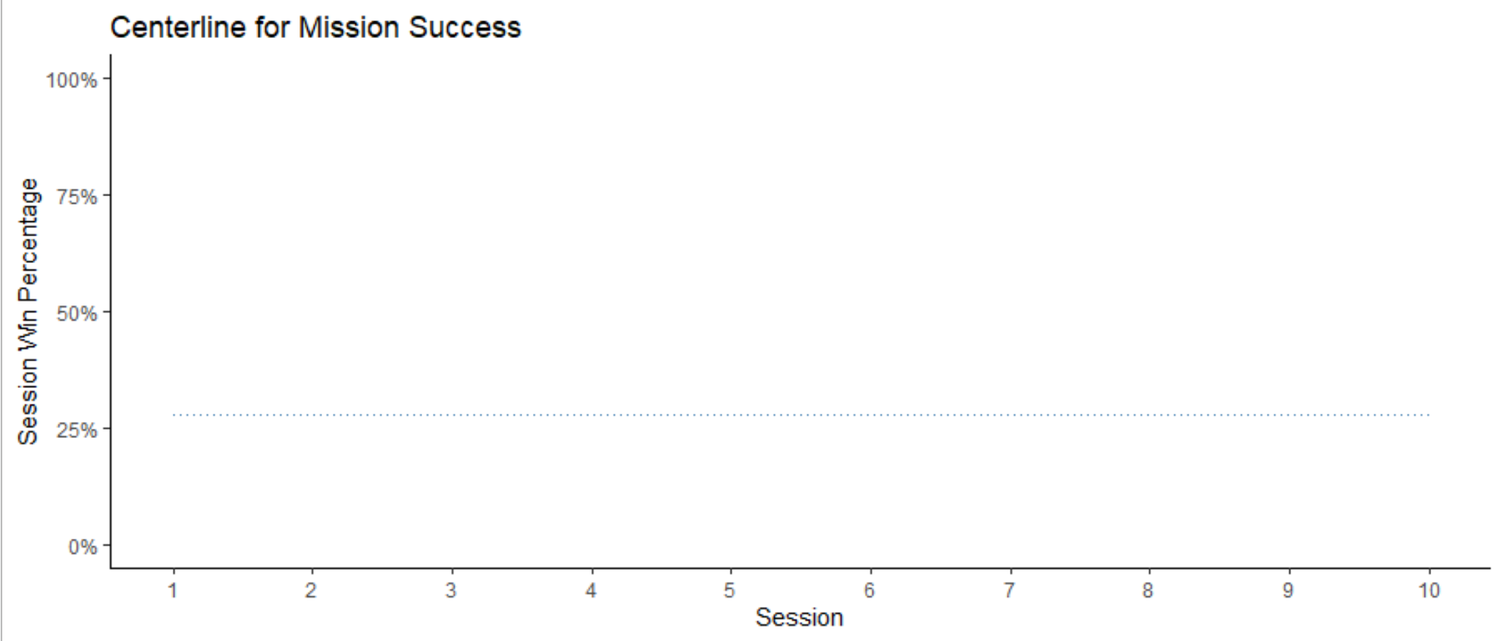

Slide 10
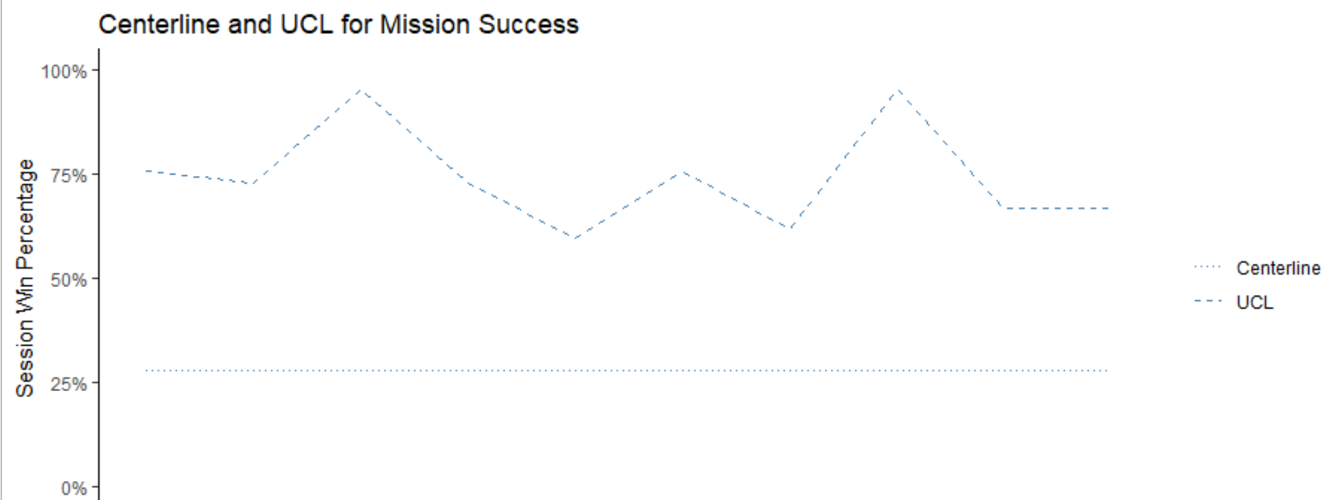
Session | 1 | 2 | 3 | 4 | 5 | 6 | 7 | 8 | 9 | 10
Attempts | 8 | 9 | 4 | 9 | 18 | 8 | 16 | 4 | 12 | 12

Slide 11
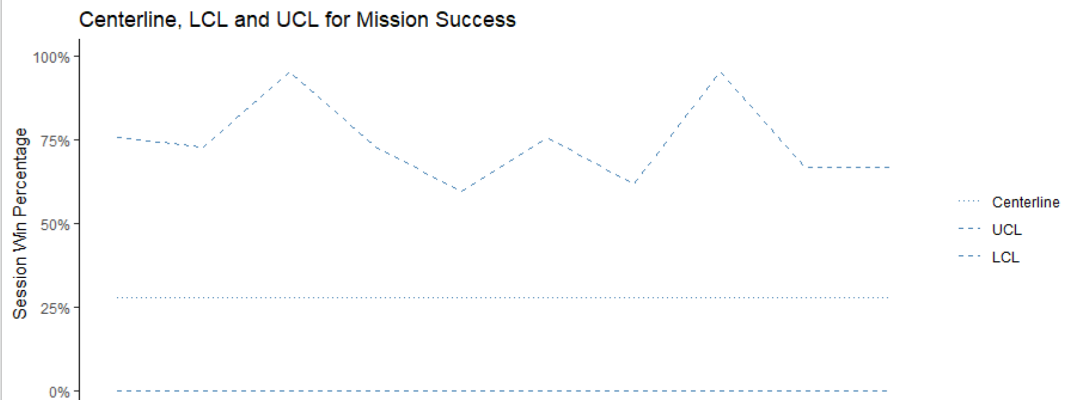
Session | 1 | 2 | 3 | 4 | 5 | 6 | 7 | 8 | 9 | 10
Attempts | 8 | 9 | 4 | 9 | 18 | 8 | 16 | 4 | 12 | 12

Slide 13
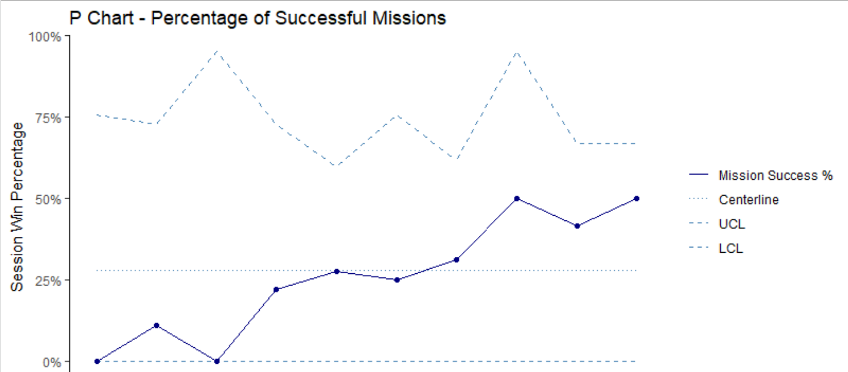
Session | 1 | 2 | 3 | 4 | 5 | 6 | 7 | 8 | 9 | 10
Sucesses | 0 | 1 | 0 | 2 | 5 | 2 | 5 | 2 | 5 | 6
Attempts | 8 | 9 | 4 | 9 | 18 | 8 | 16 | 4 | 12 | 12

Slide 14


Results
Binary Outcomes
Sample size not constant
Discrete Data
Independence

Slide 15


What to Do?
Non-Random Variation
Try to measure with a moving range?

Slide 16


X Bar and R Chart
Continuous Data
Sample size between 2 and 10
X Bar charts sample means
R Chart displays sample range

Slide 17
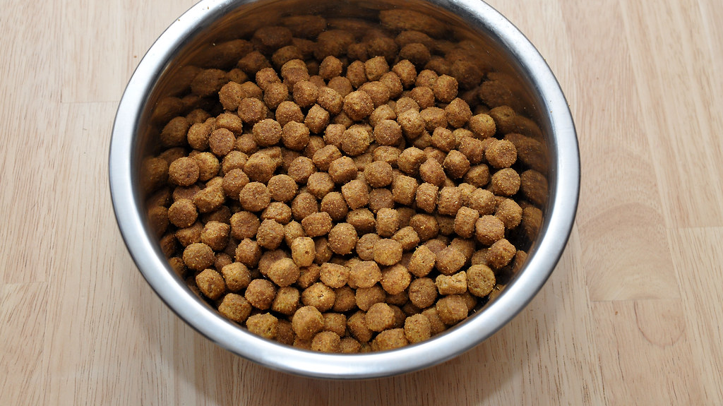
The Experiement
1.5 cups of Purina kibble
Time to clean bowl
5 Days
2 feedings per day

Slide 18

Important Factors
Mean time to finish food – Xbar
UCL and LCL for Xbar chart
UCL = Xbar + 1.880*Xbar
LCL = Xbar – 1.880*Xbar
Mean sample range for R Chart
UCL and LCL for R chart
UCL = mean*3.267
LCL = mean*0

Slide 19
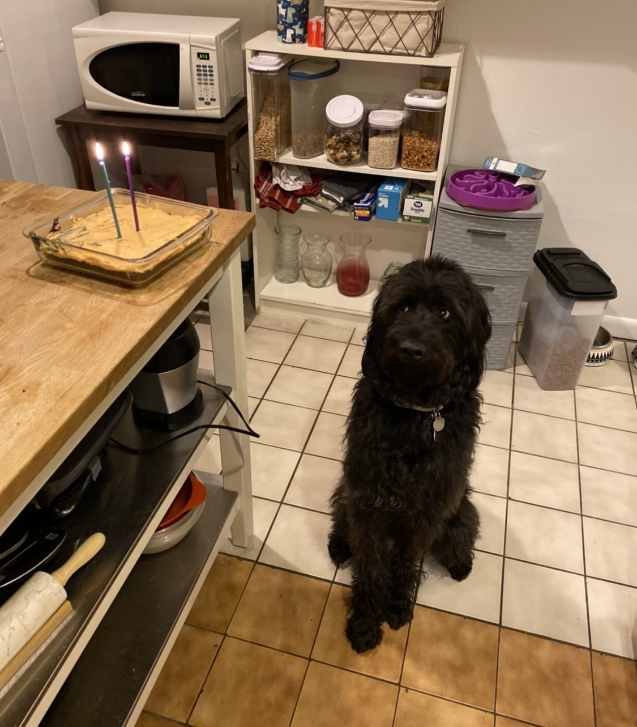
The Subject
Name: Laila
Age: 2
Weight: 55lbs
Lust for life
Avid eater

Slide 20
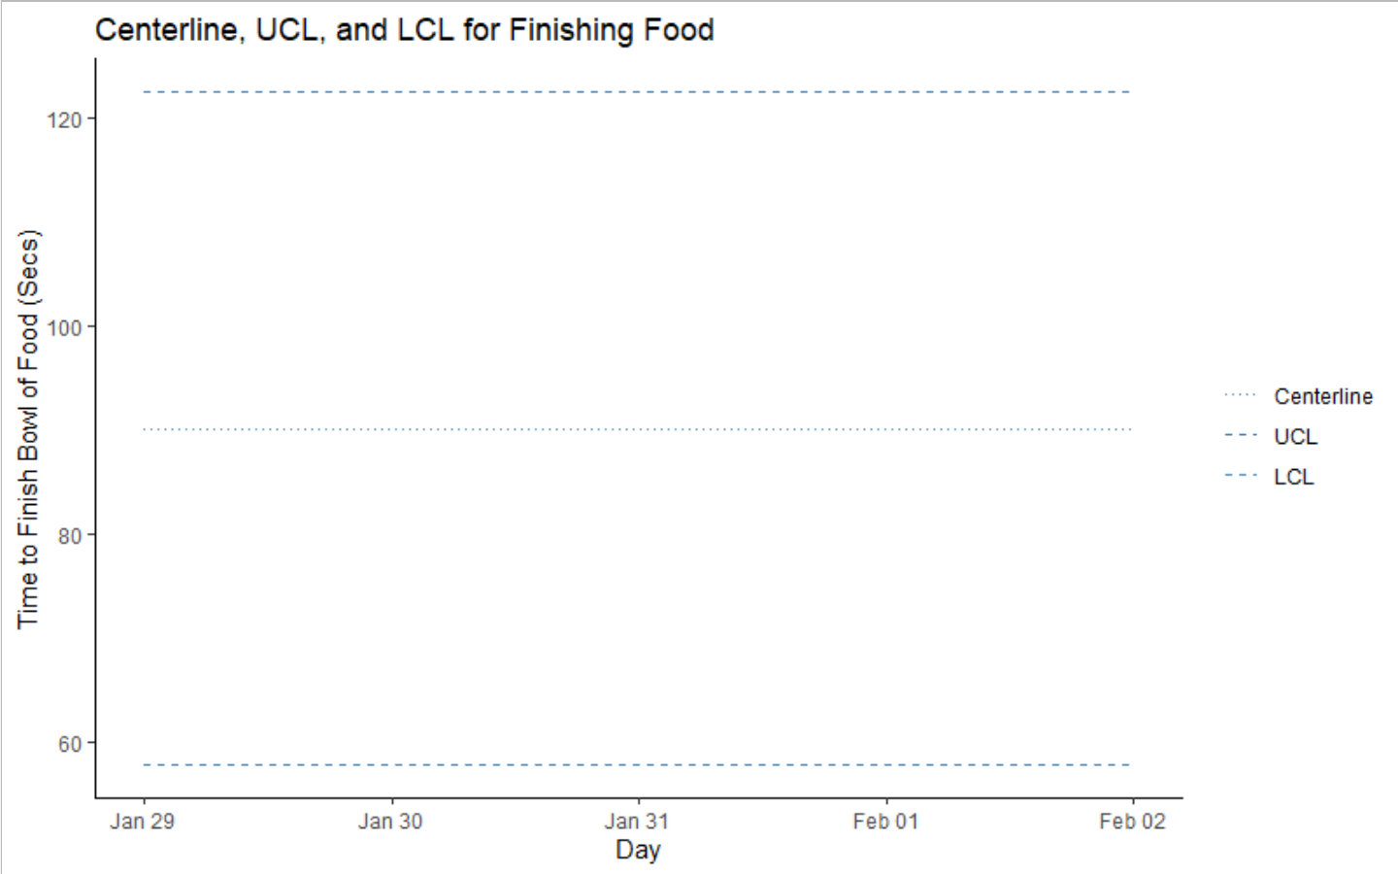

Slide 22
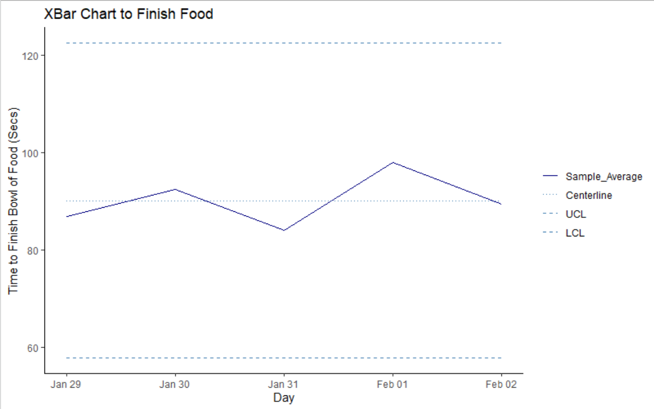

Slide 23
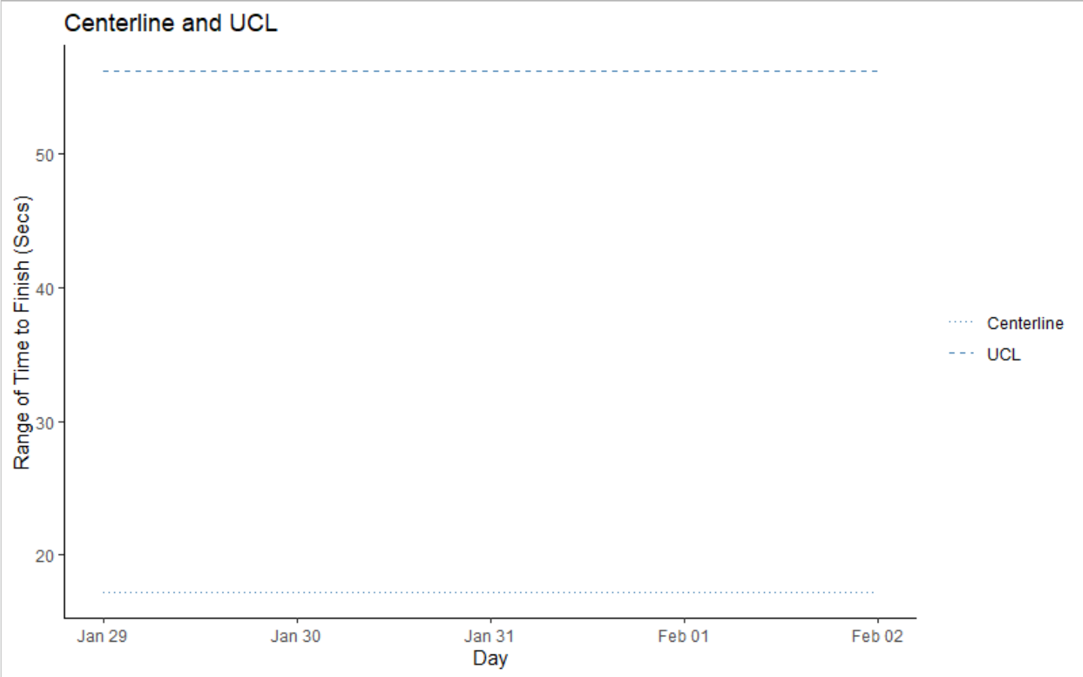

Slide 24
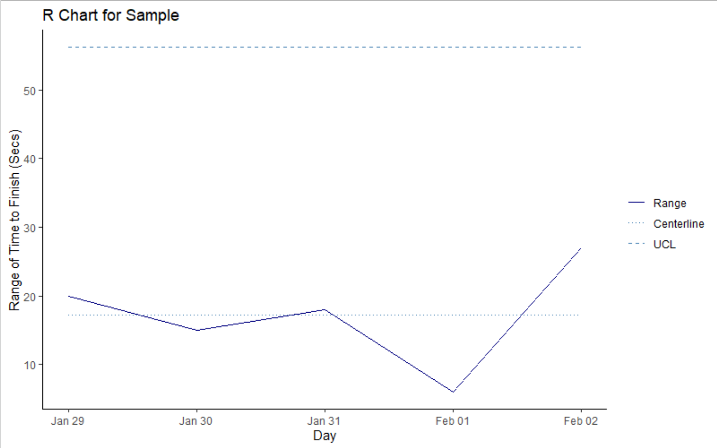

Slide 25
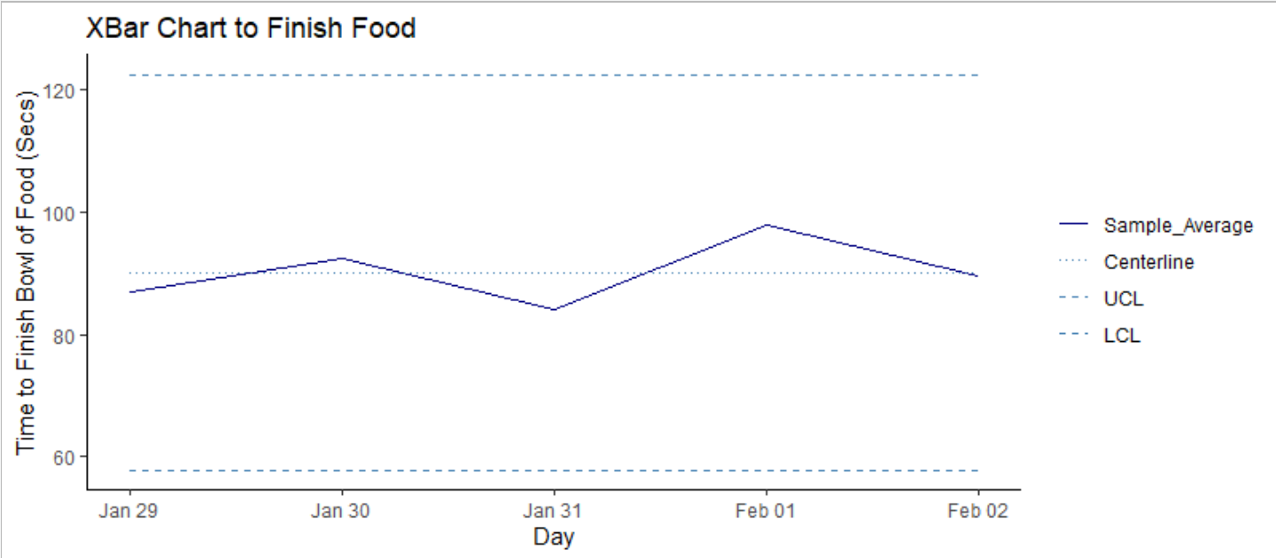
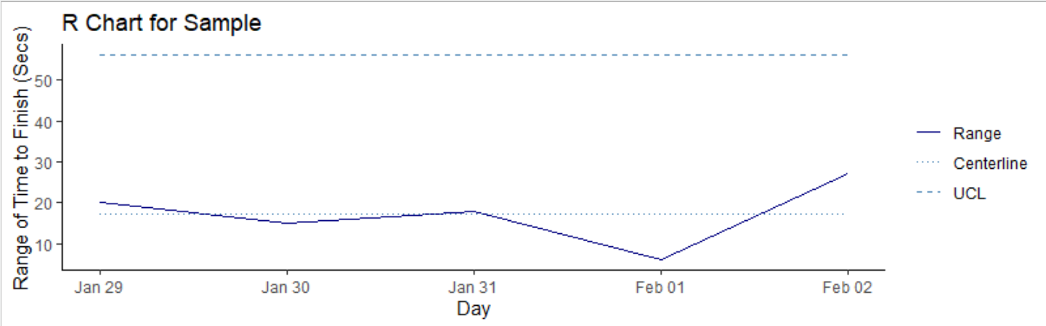

Slide 26
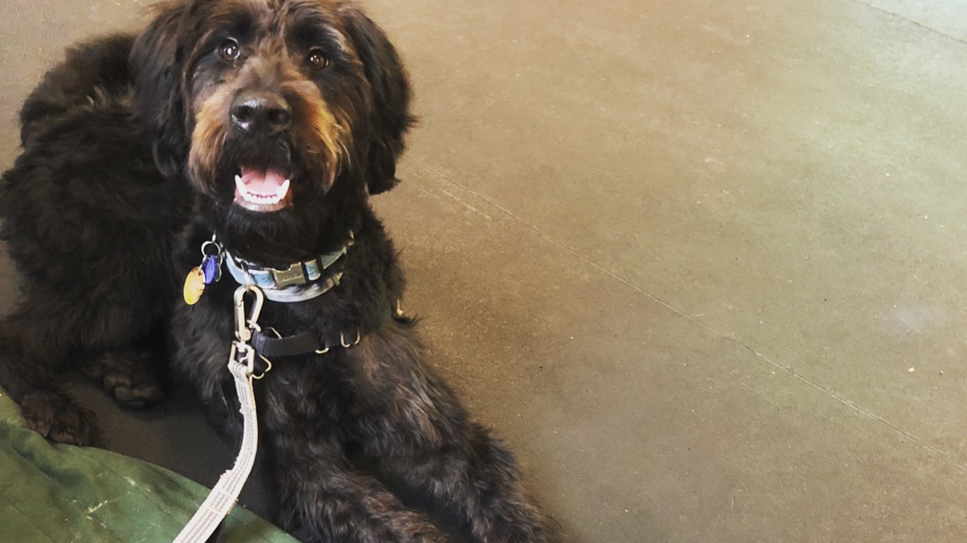
Results
Variance shows no obvious trends
Unexplainable
Process is in Control

Slide 27
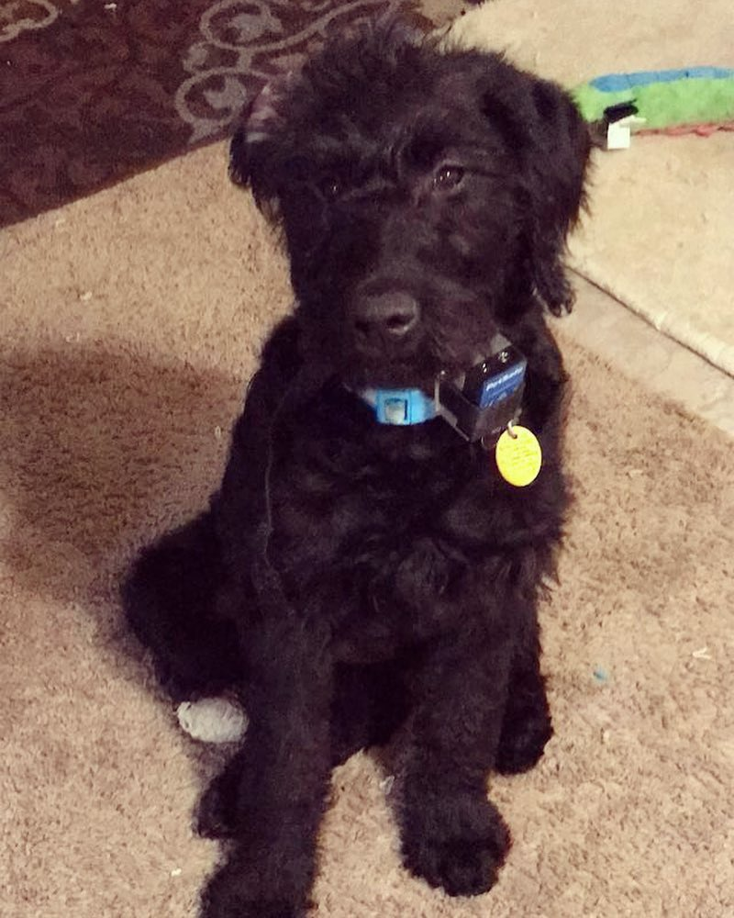
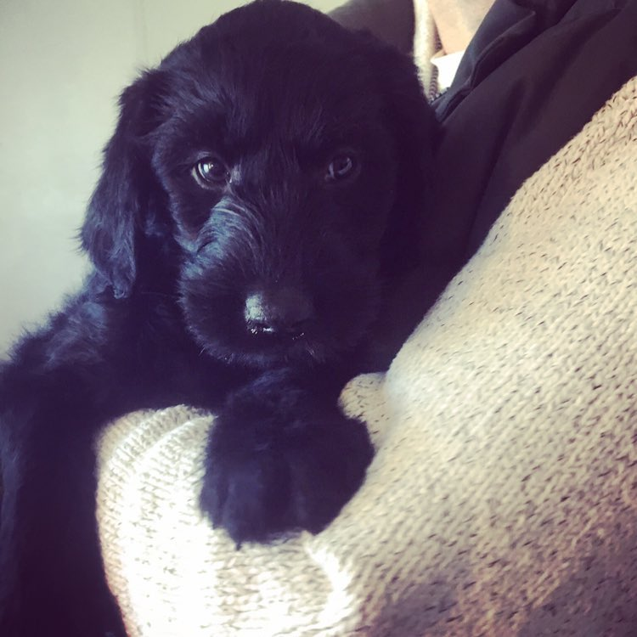
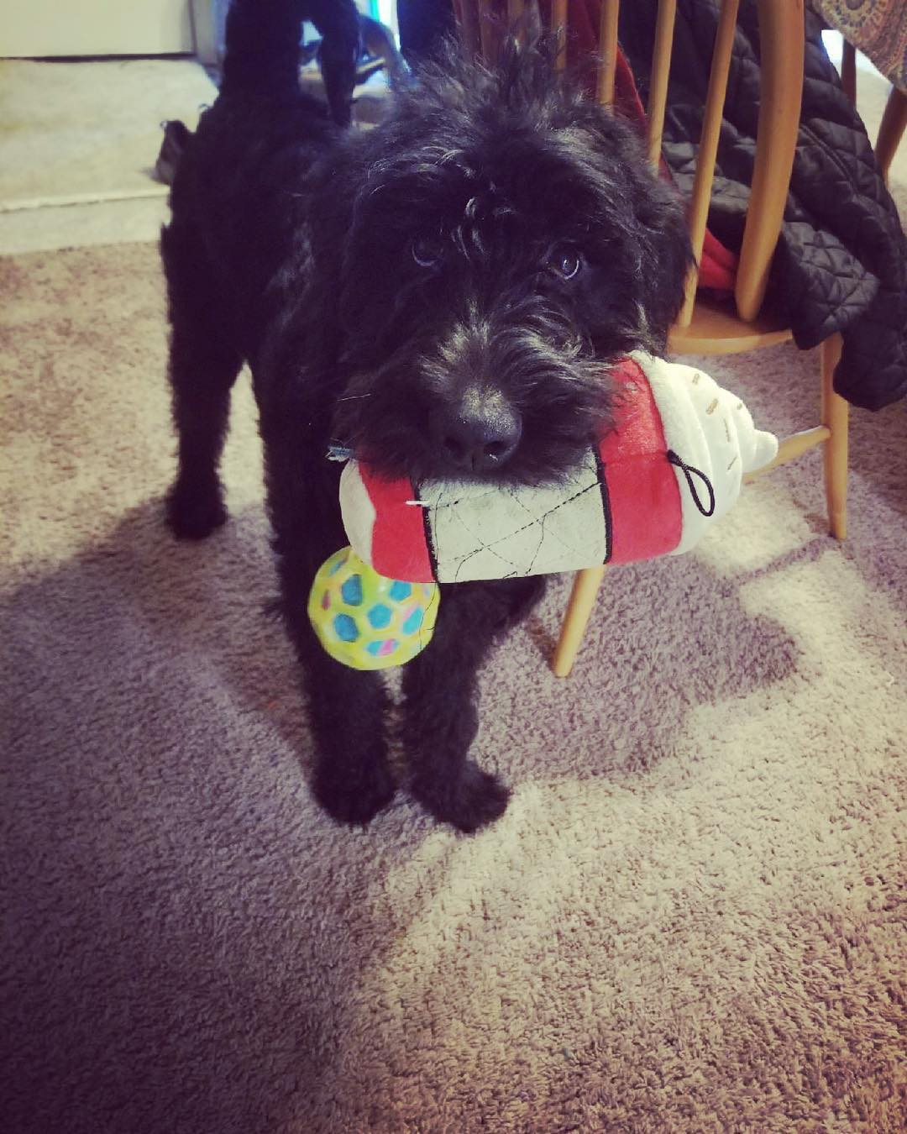
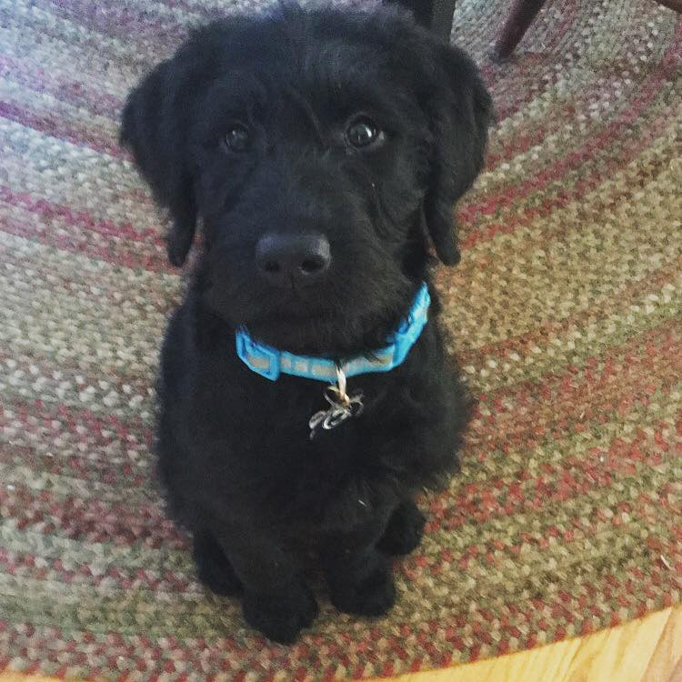
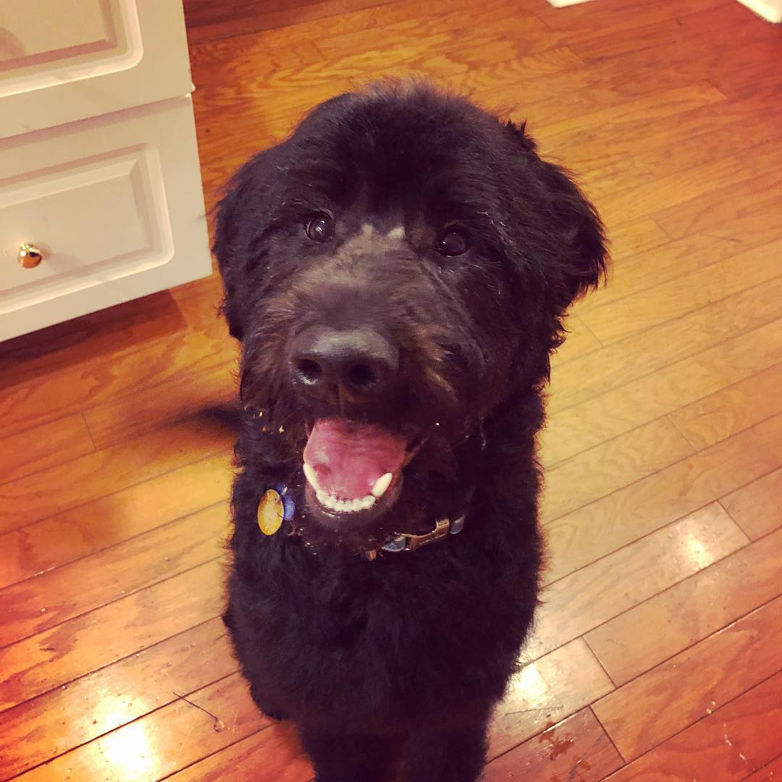
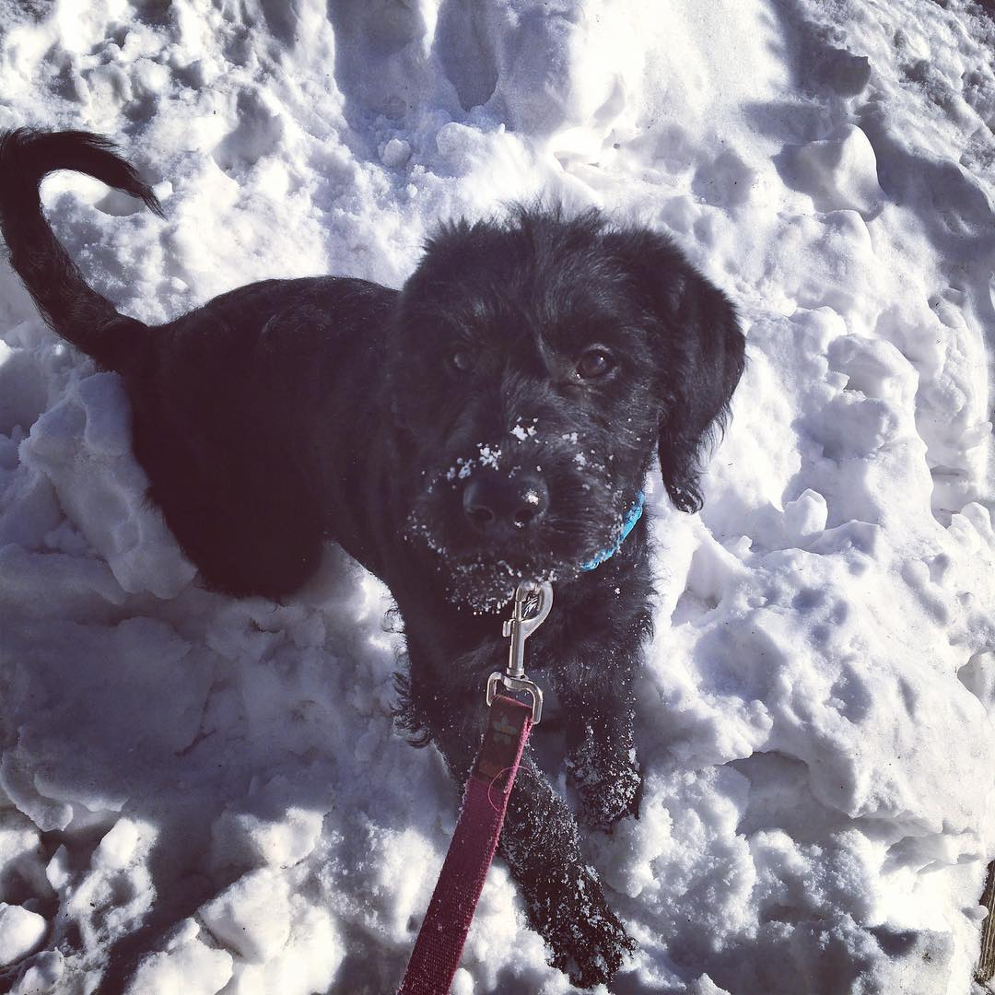

Slide 28


Questions?

Slide 29



Thank You
Presentation, data sets and code available on github
https://github.com/brianjcurryjr/CHOP

